Slide 1
Civilization
Barbarians
Savages

Slide 2
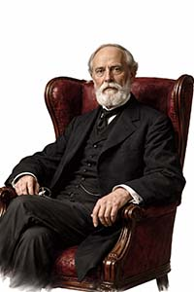
Examples from L.H. Morgan
Civilization:
Begins with the use of phonetic alphabet (excludes Chinese).
Upper Barbarism:
Homeric Age Greece
Germanic Tribes 2000 years ago
Middle Barbarism:
Village Indians of New Mexico
Ancient Britons
Lower Barbarism:
Eastern US Indian Tribes
Others with pottery but without domestic animals.
Upper Savagery:
Northern Canadian Indian Tribes
Northwest Coast Indian Tribes
Middle Savagery:
Australian Aborigines
Polynesians
Lower Savagery:
No currently living examples
No reputable anthropologist has believed this stuff more than in 100 years!
The Civilized
Upper Barbarians
Middle Barbarians
Lower Barbarians
Upper Savages
Middle Savages
Lower Savages

